Slide 1
COS 212 Graphs: Shortest Paths

Slide 2
Graphs: Shortest Path
A graph is a data structure made up of vertices
Vertices are interconnected by means of edges
The “weight” of the edge is used to represent how difficult or costly it is to move from one node to another node
It is often important to know what path between two nodes that are not directly connected is the cheapest, or shortest
A
15
23
2
D
B
C
8
9
7
3
E
F
G
15

Slide 3
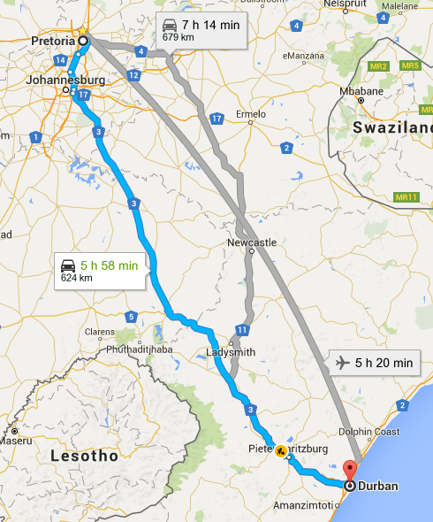
Graphs: Shortest Path
Suppose you are travelling from Pretoria to Durban
You ask the GPS what is the best way to travel down to the coast
Flying a straight line is the best, but let’s assume you want to take a road trip
What is the best route?
Shortest!
Cheapest?
You want the GPS to consider the options and tell you exactly what turns to take to get to your destination

Slide 4
Graphs: Shortest Path
Suppose you are travelling from Pretoria to Durban
What route is the best?
Let’s find the shortest path!
N
13
9
L
10
P
Z
2
3
3
11
J
H
D
15

Slide 5
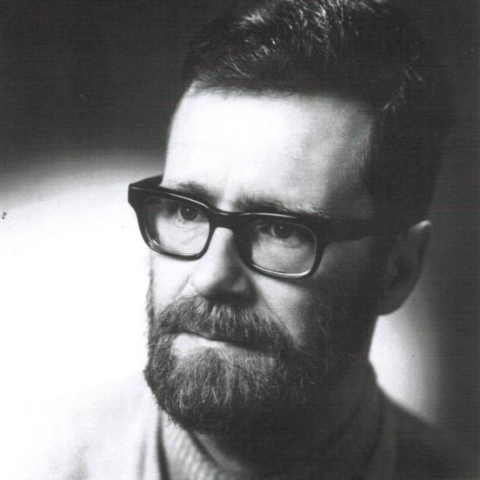
Graphs: Shortest Path
The shortest path will have a starting point: P (for Pretoria)
We will also have an endpoint: D (for Durban)
We’ll use Dijkstra’s algorithm to find shortest path from P to D
Invented by computer scientist Edsger W. Dijkstra in 1956
One of the best-known shortest path algorithms out there!
N
13
9
L
10
P
Z
2
3
3
11
J
H
D
15

Slide 6
Dijkstra’s Algorithm
For graph traversal algorithms, we saw that every vertex maintained a number variable that showed whether the vertex had already been visited
For the shortest path, every vertex will maintain a number variable to store its distance from the start vertex
At the beginning of the algorithm
Set start.dist = 0;
For the rest of the vertices, dist = Infinity (i.e. unknown)
Remembering the distance is not enough!
To be able to reconstruct the shortest path, every vertex must also remember its “shortest path” predecessor
(null, ∞)
N
13
9
(null, ∞)
L
10
P
Z
(null, 0)
(null, ∞)
3
2
3
11
J
H
D
15
(null, ∞)
(null, ∞)
(null, ∞)

Slide 7
Dijkstra’s Algorithm
Add all vertices to an “unvisited vertex” bucket
Set current = vertex with smallest distance (initially, start vertex)
For every unvisited adjacent vertex n of current, calculate its distance from the start, through current
newdist(n) = current.dist + newdist(n) = edge(current, n)
“If we travel to n through current, how long will it take?”
For current = P
newdist(J) = dist(P) + edge(P,J) = 0 + 2
newdist(N) = dist(P) + edge(P,N) = 0 + 13
We are looking for the shortest path: If current makes distance to n smaller, current is on the shortest path to n found so far
if newdist(n) < n.dist, set n.dist = newdist(n), n.prev = current
All neighbours considered, so remove current from “unvisited” bucket, set current = vertex with min dist, repeat from step 2!
(P, 13)
(null, ∞)
N
13
9
(null, ∞)
L
10
P
Z
(null, 0)
(null, ∞)
3
2
3
11
J
H
D
15
(null, ∞)
(P, 2)
(null, ∞)
(null, ∞)

Slide 8
Dijkstra’s Algorithm
while (!unvisited.empty()) {
curr = vertex in unvisited with min dist
remove curr from unvisited
for (each unvisited neighbour v of curr) {
newDist = curr.dist + length(curr, v)
if (newDist < v.dist) {
v.dist = newDist
v.prev = curr
}
}
}
Iteration: | Init
curr:
P | 0
J | ∞
N | ∞
L | ∞
H | ∞
Z | ∞
D | ∞
1
P
2
J
3
N
4
H
5
L
6
Z
(P, 13)
(null, ∞)
N
13
9
(null, ∞)
10
(H, 28)
2
P
L
Z
13
13
(null, ∞)
(N, 22)
(null, 0)
(H, 20)
3
∞
∞
22
20
2
3
11
∞
17
17
J
H
D
15
∞
∞
∞
(null, ∞)
28
(P, 2)
(Z, 31)
(null, ∞)
(null, ∞)
28
(J, 17)
∞
∞
∞
∞
∞
31

Slide 9
Dijkstra’s Algorithm
(P, 13)
N
13
9
(H, 28)
L
10
P
Z
(null, 0)
(H, 20)
3
2
3
11
J
H
D
15
(P, 2)
(J, 17)
(Z, 31)
So… What is the shortest path?
The predecessor vertices can tell us!
Two ways to use Dijkstra’s algorithm
To find the shortest path between A and B
Given A, to determine the shortest paths to every vertex in the graph
The latter is referred to as shortest-path tree

Slide 10
Shortest Paths: Dijkstra’s Algorithm
Dijkstra(Graph, start){
create vertex set unvisited
for (each vertex v in Graph) { // Initialization
v.dist = INFINITY // Unknown distance from start to v
v.prev = null // Previous node in shortest path
add v to unvisited // All vertices initially unvisited
}
start.dist = 0 // Distance from start to start (0)
while (!unvisited.empty()) {
curr = vertex in unvisited with min dist // will be start
remove curr from unvisited
for (each unvisited neighbour v of curr) {
newDist = curr.dist + length(curr, v)
if (newDist < v.dist) {
v.dist = newDist;
v.prev = curr;
}
}
}
What data structure would you use for “unvisited”?
Using a min heap can significantly improve the performance
Notes:
Section 8.3.

Slide 11
How Reliable is Dijkstra’s Algorithm?
6
6
(null, 0)
(A, 2)
(null, 0)
(A, 2)
(B, 5)
(B, 5)
(A, 6)
(A, 6)
A
2
B
3
C
A
2
B
3
C
100
1
100
-100
D
D
(A, 100)
(A, 100)
Iteration: | Init
curr:
A | 0
B | ∞
C | ∞
D | ∞
1
A
2
6
100
2
B
5
100
3
C
100
4
D
100
Iteration: | Init
curr:
A | 0
B | ∞
C | ∞
D | ∞
1
A
2
6
100
2
B
5
100
3
C
100
4
D
100
0
3
Dijkstra’s algorithm will never realize that D offers a shorter path!

Slide 12
Shortest Paths: The Bellman-Ford Algorithm
BellmanFord(Graph, start){
for each vertex v in Graph { // Initialization
v.dist = INFINITY // Unknown distance from start to v
v.prev = null // Previous node in shortest path
}
start.dist = 0 // Distance from start to start = 0
while there is an edge(v,u) such that
u.dist > v.dist + length(v,u) // following edge(v,u) gives
{ // a shorter path to u
u.dist = v.dist + length(v,u)
u.prev = v
}
}
}
Go through all the edges repeatedly until the shortest paths are determined
Slower than Dijkstra, but works even with negative weights!
Notes:
Section 8.3.

Slide 13
Bellman-Ford Algorithm: Example
Find the shortest path from a to all other vertices
BellmanFord(Graph, start)
for each vertex v in Graph {
v.dist = INFINITY
}
start.dist = 0
while there is an edge(v,u) such that
u.dist > v.dist + length(v,u)
{
u.dist = v.dist + length(v,u)
}
2
(a,2)
5
(b,7)
a
b
c
2
2
-3
9
4
5
d
(a,2)
e
(b,-1)
f
(a,2)
(g,-2)
(e,4)
(e,3)
1
-5
Iteration: | Init
a | 0
b | ∞
c | ∞
d | ∞
e | ∞
f | ∞
g | ∞
1
2
g
(d,3)
2
7
Edges: ab ad ae bc be ce de dg ef ge
2
2
-1
-2
4
3
Need a data structure to hold edges!
3
Notes:
Cf. Figure 8.8.

Slide 14
Fixing Dijkstra’s Algorithm
Bellman-Ford works, but is somewhat wasteful
Can’t we fix Dijkstra’s algorithm instead?
while !unvisited.empty() {
curr = vertex in unvisited with min dist
remove curr from unvisited
for (each unvisited neighbour v of curr) {
newDist = curr.dist + length(curr, v)
if (newDist < v.dist) {
v.dist = newDist;
v.prev = curr;
}
}
}
Should we really remove it?
Visit all neighbours?
Add vertex back to the bucket if dist changes?

Slide 15
Shortest Paths: Label Correcting Algorithm
labelCorrecting(Graph, start){
create vertex set toBeChecked
for (each vertex v in Graph) { // Initialization
v.dist = INFINITY // Unknown distance
v.prev = null // Previous node in shortest path
}
start.dist = 0
toBeChecked.add(start);
while (!toBeChecked.empty()) {
curr = toBeChecked.removeVertex()
for (each neighbour v of curr) { // even the visited ones
newDist = curr.dist + length(curr, v)
if (newDist < v.dist) {
v.dist = newDist;
v.prev = curr;
if (!toBeChecked.contains(v))
toBeChecked.add(v);
}
}
}
}
Use a queue for the “toBeChecked” bucket!
Put v in the queue if v gets updated!
Notes:
Section 8.3.

Slide 16
Label Correcting Algorithm with Queue
2
(a,2)
5
(b,7)
Works on negative weights, and does not waste as much time as Bellman-Ford
a
b
c
2
2
-3
9
(e,4)
4
5
(e,3)
d
(a,2)
e
f
(a,2)
(b,-1)
(g,-2)
Iter:
curr:
Queue: | a
a | 0
b | ∞
c | ∞
d | ∞
e | ∞
f | ∞
g | ∞
1
2
3
4
5
6
7
8
9
Init
1
-5
b
d
e
g
f
f
g
a
b
c
e
f
(d,3)
d
e
c
c
g
f
d
e
g
f
e
e
create vertex set toBeChecked
for (each vertex v in Graph) {
v.dist = INFINITY
v.prev = null
}
start.dist = 0
toBeChecked.add(start);
while (!toBeChecked.empty()) {
curr = toBeChecked.removeVertex()
for (each neighbour v of curr) {
newDist = curr.dist + length(curr,v)
if (newDist < v.dist) {
v.dist = newDist;
v.prev = curr;
if (!toBeChecked.contains(v))
toBeChecked.add(v);
}
}
}
e
c
g
f
2
7
2
2
-1
-2
4
3
3
Notes:
Cf. Figure 8.8.

Slide 17
Dijkstra vs Bellman-Ford vs Label-Correcting
6
A
2
B
3
C
100
-100
D
Dijkstra
Visit each vertex once, starting with minimum distance vertex
For each visited vertex, evaluate the distance of adjacent vertices from the starting point
Bellman-Ford
Iterate over edges rather than vertices
Update the origin-to-vertex distances based on edge weights
Iterate until no improvements are observed
Label correcting
Dijkstra with a queue, allowing re-visiting of vertices

Slide 18
Shortest Paths: All to All
All the algorithms discussed so far discover the shortest paths from vertex i to any other vertex in the graph
Can we find all the shortest paths from any vertex to any other vertex?
We can calculate the adjacency matrix of shortest paths using the Floyd–Warshall algorithm (named after W. Floyd and S. Warshall)
let weight be a |V| × |V| array of minimum distances initialized to infinity
for each vertex v
weight[v][v] = 0
for each edge(u,v)
weight[u][v] = w(u,v) // the weight of the edge(u,v)
FWalgorithm(Matrix weight)
for i = 1 to |V|
for j = 1 to |V|
for k = 1 to |V|
if weight[j][k] > weight[j][i] + weight[i][k]
weight[j][k] = weight[j][i] + weight[i][k]
6
 | A | B | C | D
A | 0 | 0 | 3 | 1
B | ∞ | 0 | 3 | ∞
C | ∞ | ∞ | 0 | ∞
D | ∞ | -1 | 2 | 0
A
2
B
3
C
adjacency
matrix
1
-1
D

Slide 19
Shortest Paths: All to All
let weight be a |V| × |V| array of minimum distances initialized to infinity
for each vertex v
weight[v][v] = 0
for each edge(u,v)
weight[u][v] = w(u,v) // the weight of the edge (u,v)
6
 | A | B | C | D
A | 0 | ∞ | ∞ | ∞
B | ∞ | 0 | ∞ | ∞
C | ∞ | ∞ | 0 | ∞
D | ∞ | ∞ | ∞ | 0
 | A | B | C | D
A | 0 | 2 | 6 | 1
B | ∞ | 0 | 3 | ∞
C | ∞ | ∞ | 0 | ∞
D | ∞ | -1 | ∞ | 0
A
2
B
3
C
1
-1
D
Initialise intersections to
existing edges

Slide 20
Shortest Paths: All to All
6
A
2
B
3
C
for i = 1 to |V|
for j = 1 to |V|
for k = 1 to |V|
if weight[j][k] > weight[j][i] + weight[i][k]
weight[j][k] = weight[j][i] + weight[i][k]
1
-1
D
At every iteration, determine: Given i, j, k, will the path from j to k be cheaper if it goes through i ?
 | A | B | C | D
A | 0 | 2 | 6 | 1
B | ∞ | 0 | 3 | ∞
C | ∞ | ∞ | 0 | ∞
D | ∞ | -1 | ∞ | 0
 | A | B | C | D
A | 0 | 2 | 5 | 1
B | ∞ | 0 | 3 | ∞
C | ∞ | ∞ | 0 | ∞
D | ∞ | -1 | 2 | 0
i = 1: A
i = 2: B
 | A | B | C | D
A | 0 | 2 | 5 | 1
B | ∞ | 0 | 3 | ∞
C | ∞ | ∞ | 0 | ∞
D | ∞ | -1 | 2 | 0
 | A | B | C | D
A | 0 | 0 | 3 | 1
B | ∞ | 0 | 3 | ∞
C | ∞ | ∞ | 0 | ∞
D | ∞ | -1 | 2 | 0
i = 3: C
i = 4: D

